Slide 1
Object Oriented Programming
Objects, Inheritance, Encapsulation
Java
FRC Java

Slide 2
Bigger Object 27
Object 1
Parameter 1
Parameter 2
Function A
Function B
Function 27.A
Function 27.B
Function 27.C
Function 27.D
Function 27.E
Function 27.F
Object 2
Parameter 1
Function C
Object 3A
Parameter 1
Object 3
Function D

Slide 3
Talon
Port
Inverted
Speed Controller
set(speed)
Digital Input (Limit Switch)
Port
get()
Sensor
Port
get()

Slide 4
Linear Actuator
Talon Speed Controller
Move(speed)
moveUp()
moveDown()
isTop()
isBottom()
Top Limit Switch
Bottom Limit Switch

Slide 5
ArmSystem
PIDController
Linear Actuator
moveArm(speed)
moveArmUp()
moveArmDown()
moveArmTop()
moveArmBottom()
moveArmHome()
moveArmOffHome()
saveHomeSetpoint()
setArmSetpoint(ix)
moveArmSetpoint()
isOnTarget()
isTop()
isBottom()
isHome()
initArmPID()
Etc.
Analog Potentiometer
Home Limit Switch

Slide 6
Java Basic
http://docs.oracle.com/javase/tutorial/
http://docs.oracle.com/javase/tutorial/java/concepts/index.html
FRC Java
https://wpilib.screenstepslive.com/s/4485/m/13809
RobotBuilder
https://wpilib.screenstepslive.com/s/4485/m/26402

Slide 7
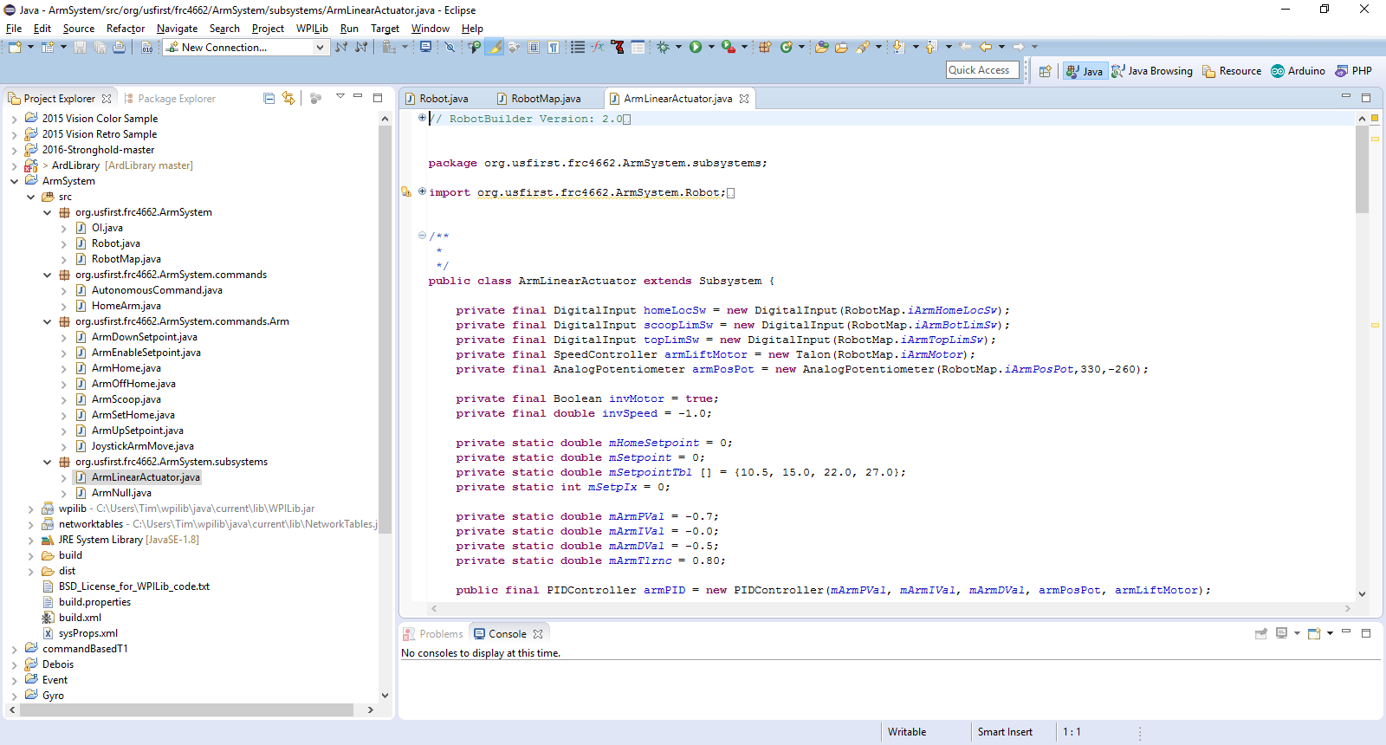
Eclipse IDE
Integrated Development Environment
Open Source eclipse.org
Add-ons for many languages
Real-time syntax and reference validation
WPIlib extensions for FRC authorized objects
3rd party support for optional add-ons
e.g. Original Equipment Manufacturers may provide Java/C++ code for their products as either samples or libraries
https://eclipse.org/home

Slide 8
Eclipse
ArmSystem

Slide 9
Drive
PIDController
Encoder
otherstuff2
PIDController
Gyro
Left Right Drive
Left Speed Controller
Right Speed Controller

Slide 10
EXERCISES
Arm System
Initialize (replace current autonomous)
Fix isOnTarget logic
Capture Setpoint Values into Table
Read Setpoint Table from File
Save Setpoint Table to File
Drive will be discussed later

